Slide 1
TNSDC-Generative AI
Face Comparison in Deep learning using CNN
Presented by :Pradeep.p,
au211521104109,
Pre-Final Student,
Computer Science and Engineering,
Panimalar Institute of Technology.

Slide 2

OUTLINE
Problem Statement
Proposed Solution
System Approach
Algorithm
Result
Conclusion
References

Slide 3
PROBLEM STATEMENT
The problem statement of face comparison involves developing algorithms or systems to compare two facial images and determine the degree of similarity or dissimilarity between them. This can be used for various applications such as identity verification, biometric security, forensic analysis, and entertainment purposes. The goal is to accurately identify and quantify the resemblance or differences between facial features, despite variations in pose, lighting, expression, and other factors.

Slide 4
PROPOSED SOLUTION
There are several approaches to face comparison, depending on the context and requirements. One common solution is to use facial recognition technology, which involves detecting facial features, creating a unique facial signature, and then comparing it with other facial signatures in a database. Another approach is to use deep learning algorithms trained on large datasets to analyze and compare facial features. Additionally, some solutions utilize biometric data such as fingerprints or iris scans for more accurate identification. Each solution has its own advantages and limitations, and the choice depends on factors like accuracy, scalability, and privacy concerns.
. In deep learning, face comparison typically involves using convolutional neural networks (CNNs) to extract facial features and then comparing these features to determine similarity or identity. One popular approach is to use Siamese networks, where two identical CNNs process two different images.
It’s important to note that deep learning-based face comparison systems require large amounts of labeled data for training, and they may face challenges such as bias, privacy concerns, and robustness to variations in lighting, pose, and expression. Regular updates and monitoring are necessary to ensure optimal performance and mitigate potential biases or inaccuracies.
. Train the Siamese network using pairs of images along with their corresponding labels indicating whether the faces are the same or different. The network learns to minimize the distance between embeddings of the same person’s faces and maximize the distance between embeddings of different people’s faces.

Slide 5
SYSTEM APPROACH
Hardware:
CPU: The system requires a CPU with sufficient processing power to handle the computational demands of Convolutional Neural Network (CNN) training and inference. A multi-core processor, preferably with a clock speed of at least 2 GHz or higher, is recommended.
Memory: A minimum of 8 GB RAM is recommended for smooth operation, especially during model training, where large datasets are processed. More RAM may be required for handling larger datasets or concurrent user requests.
Internet Speed: A stable internet connection is necessary for downloading and updating Python packages, model weights, and serving the web application. A broadband connection with a minimum download speed of 5 Mbps and upload speed of 1 Mbps is sufficient for most purposes.

Slide 6
SYSTEM APPROACH – CONT.
Software:
Python: The system is built using Python programming language
PyTorch: PyTorch, a machine learning library, is utilized for implementing the Convolutional Neural Network (CNN) architecture. PyTorch provides efficient tensor computation with GPU acceleration, facilitating faster model training and inference.
Python-facepp – To install this module type the below command in the terminal. Pip install python-facepp emoji – To install this module type the below command in the terminal. Pip install emoji.
This app compares two photographs of the same person or two different persons against his/her face features like face landmarks, beauty score, face emotion, etc. If both photographs are matching with each other, the app result is “Both photographs are of same person ” otherwise app result is “Both photographs are of two different persons”.

Slide 7

ALGORITHM
Phase 1: Data Preparation and Preprocessing
Data Collection: Gather images or videos containing faces that you want to compare. Ensure that the images are of good quality and contain frontal views of faces with consistent lighting and background.Face Detection: Use face detection algorithms (e.g., Haar cascades, Dlib, MTCNN) to detect and extract faces from the images or videos. This step ensures that only the relevant portions of the images are used for comparison.
Phase 2: Model Training
Define a Convolutional Neural Network (CNN) architecture using pip install python face all, comparing two different images, and convert into two different url link.
A facepp API is allowed only to compare image URL links of two photographs. Convert Image to URL using postimages.org In this website, choose your photograph from your local drive by click on the “choose images” button and then this website will create different URL links after processing your photograph.
Facial recognition algorithms to compare two or more faces and determine if they belong to the same person or if there are any similarities or differences between them.

Slide 8
ALGORITHM - CONT.
Phase 3: Final Model Creation
Python-facepp – To install this module type the below command in the terminal. Pip install python-facepp emoji – To install this module type the below command in the terminal. Pip install emoji
Phase 4: Web Application Deployment
to a format suitable for inference with the CNN model.
Pass the preprocessed image data through the "server" model for inference, predicting the digit label along with associated probabilities.
Develop the server-side logic and database structure to manage user data, images, and comparison algorithms.
Face Detection and Recognition: Implement face detection and recognition algorithms to identify and extract facial features from images uploaded by users.
Conparison CNN Algorithm: Develop an algorithm to compare the facial features extracted from different images and determine the similarity score.

Slide 9
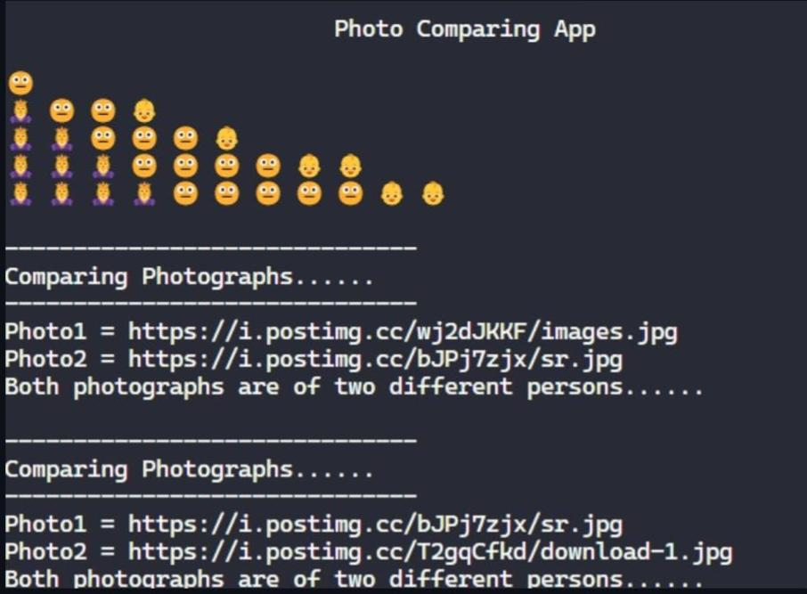
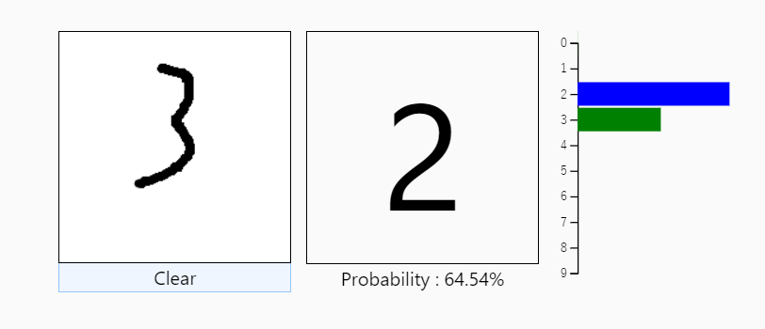
RESULT
Figure 1
9

Slide 10
Conclusion
The face comparison in deep learning offers promising avenues for various applications, including security, surveillance, and biometrics. Through advanced algorithms and neural network architectures, deep learning models can effectively extract and compare facial features, enabling accurate identification and verification tasks. Despite significant progress, challenges such as data bias, privacy concerns, and robustness to variations in pose, lighting, and expression remain. Continued research and innovation are crucial to addressing these challenges and unlocking the full potential of face comparison in deep learning for real-world applications.face comparison using deep learning techniques presents a powerful solution for various applications ranging from security to personalized user experiences. Leveraging convolutional neural networks and sophisticated algorithms, these systems can accurately analyze and compare facial features, enabling tasks such as identity verification, authentication, and emotion recognition. However, challenges such as data privacy, ethical considerations, and robustness to variations in lighting, pose, and occlusion persist. Further advancements in deep learning methodologies.
10

Slide 11
REFERENCES
Python: https://python.org/
Numpy: https://numpy.org/
PyTorch: https://pytorch.org/
Flask: https://flask.palletsprojects.com/en/3.0.x/
Inspiration: https://projectworlds.in/artificial-intelligence-project-handwritten-digits-recognition/
11

